Slide 1
UART
Universal Asynchronous Receiver/Transmitter

Slide 2
Serial & Parallel Communication

Slide 3

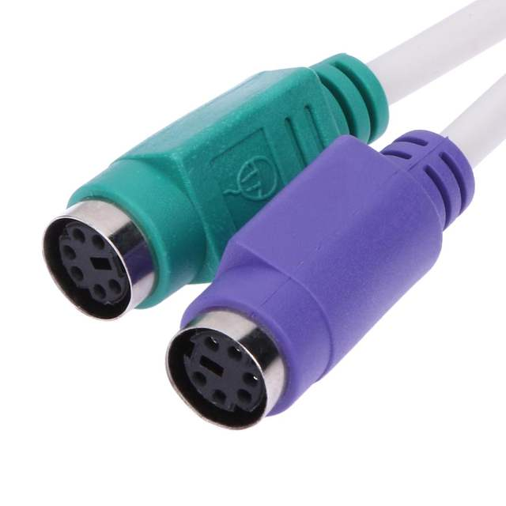
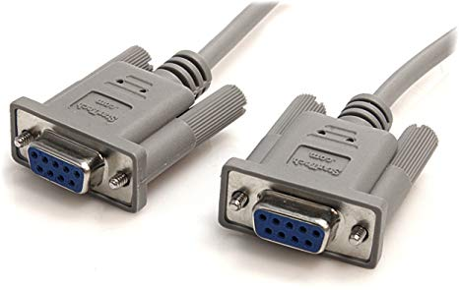
Serial Communication
Only ONE data bit is sent every clock cycle.
EXAMPLES:
UART, USART, I²C, PCI-E, RS-232, USB.
Tx
Data line
Rx
control
control

Slide 4
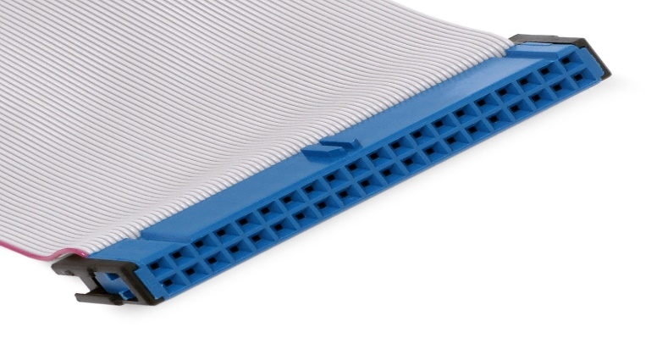
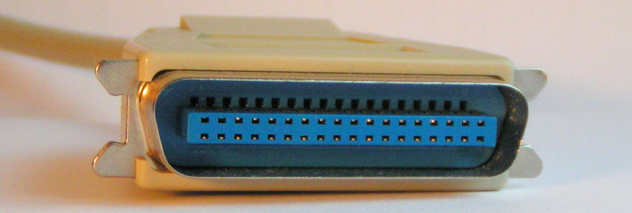
Parallel Communication
Multiple data bits are sent every clock cycle.
EXAMPLES:
Conventional PCI, IEEE-1284, Parallel ATA.
Tx
Data lines
Rx
control
control

Slide 5
Serial Vs Parallel. why is serial more popular?
 | Serial Communication | Parallel Communication
Bit/Cycle | Only one bit per cycle | Multiple bits per cycle
Speed | Slow | Fast
Hardware size | Small | Large
Disadvantages |  | Speed is affected due to clock skew. Cable length is limited due to Crosstalk.

Slide 6
Communication Circuit Types
Simplex
Tx
Rx
Half Duplex
Tx/Rx
Rx/Tx
Tx
Rx
Rx
Tx
Full Duplex

Slide 7
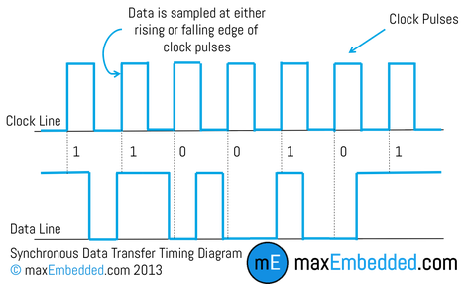
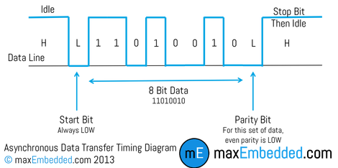
Synchronous and Asynchronous
An asynchronous protocol has no common clock line that regulates data transmission speed.
Users must set both devices to communicate at the same speed.
The receiver performs oversampling to indicate when the data is suitable to capture.
A synchronous protocol has a common clock line that regulates data transmission speed.
The receiver captures data at either the rising or falling edge of the clock.

Slide 8
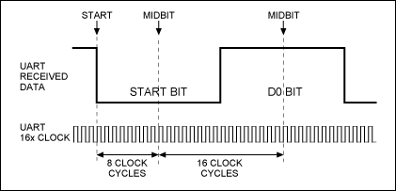
Oversampling
Transmitter clock
Oversampling is the technique used by the receiver to capture the input transmitted input bit.
Used asynchronous communication.
Instead of capturing the data once at the rising edge of a common clock.
It captures at the middle of the transmitted bit.
Sampling rate a commonly 16 or 8.
A sampling rate of N means that the receiver clock frequency must be N times that of the transmitter

Slide 9
Baud Rate
Baud rate is the number of serial bits per second that can be transmitted/received over a certain communication line.
It is a measure of the speed of the system.
A baud rate of9600, is 9.6kbps(9600bps) in a serial system.
An 8-bit parallel system with 9600 baud transmits 9600x8 bits per second(9600kBps).
This transmitter requires a clock of 9.6kHz.
Common Baud Rates(bps)
2400 | 38.4k
4800 | 57.6k
9600 | 76.8k
14.4k | 115.2k
19.2k | 230.4k
28.8k | 250k

Slide 10
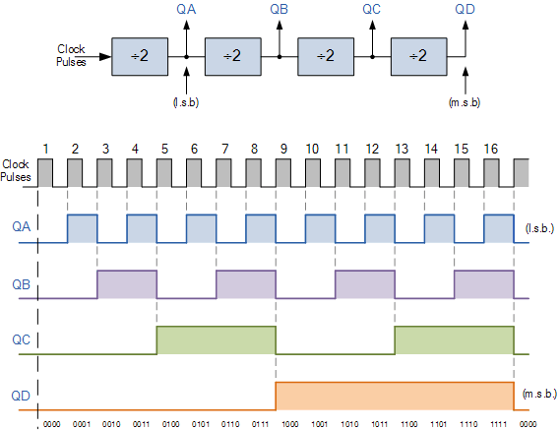
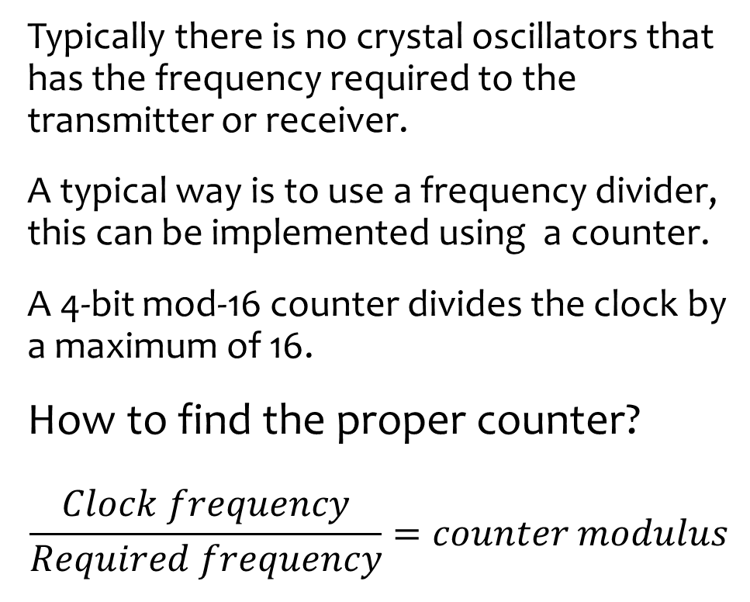
Baud Rate Generation
Typically there is no crystal oscillators that has the frequency required to the transmitter or receiver.
A typical way is to use a frequency divider, this can be implemented using a counter.
A 4-bit mod-16 counter divides the clock by a maximum of 16.
How to find the proper counter?
$$\frac{Clock frequency}{Required frequency}=counter modulus$$

Slide 11
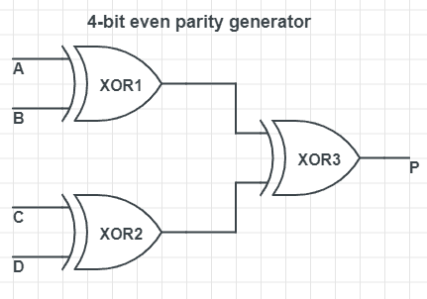
Error checking: Parity Bit
A parity bit is a basic method to check whether the received data is correct or erroneous.
It can be either even parity or odd parity.
With even parity, the bit is only 0 when the number of ones is even.
With odd parity, the bit is only 0 when the number of ones is odd.

Slide 12
The UART Circuit

Slide 13
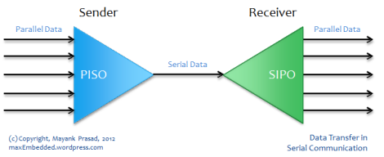
UART
UART stands for Universal Asynchronous Receiver/Transmitter.
A serial data transmission interface.
NOT a protocol or a standard.
A circuit found in microcontrollers or stand-alone IC’s.

Slide 14
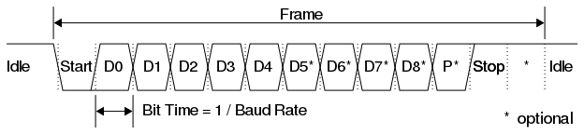
UART Frame
When idle, the transmitter send a stream of ones.
The start bit is 0.
The data length can either be 5, 6, 7, 8, or 9.
The parity bit is optional and can either be odd or even.
The stop bit/s can be 1, 1.5, or 2.

Slide 15
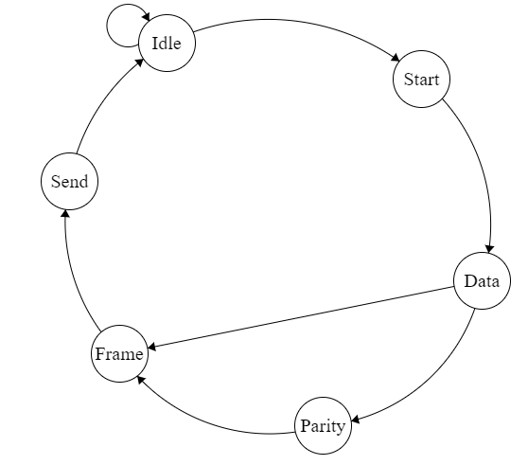
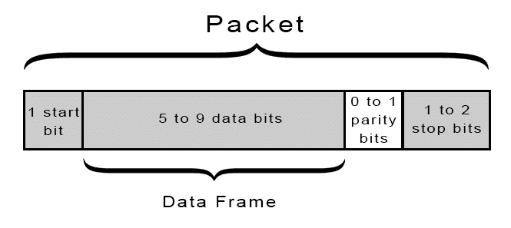
UART Operation: Transmitter

Slide 16
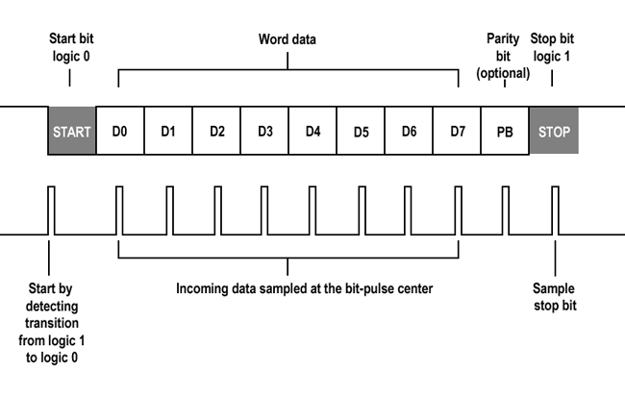
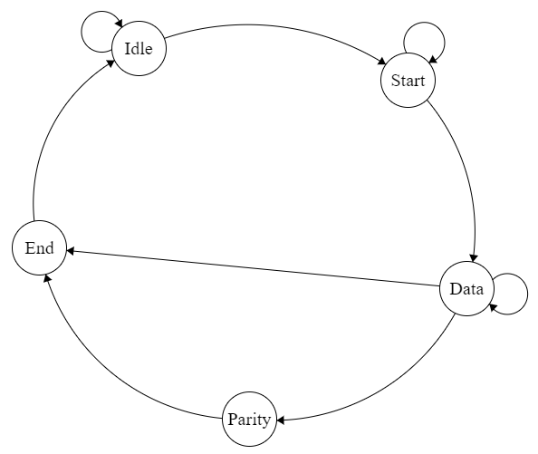
UART Operation: Receiver

Slide 17
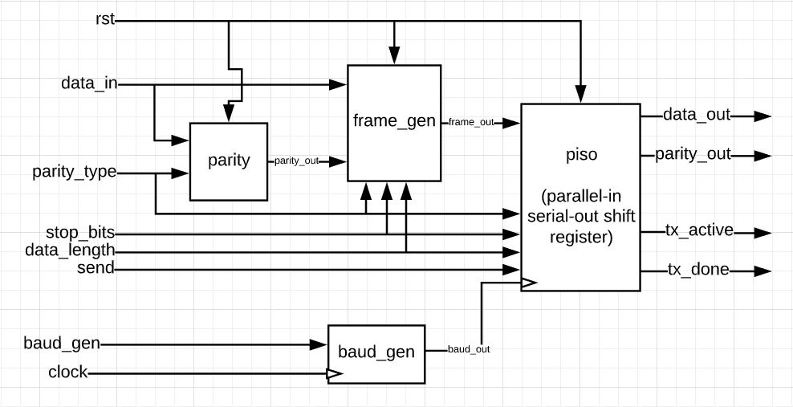
Basic Transmitter Architecture

Slide 18
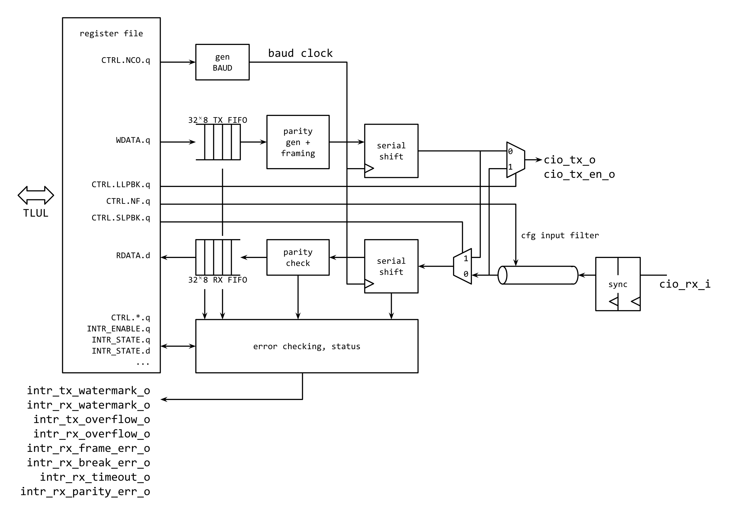
Commercial UART Architecture
Source: opentitan.org

Slide 19

Questions?!.....Maybe

